Slide 1

CUSTOMER CHURN
& RETENTION ANALYTICS
Turning customer behavior into retention decisions
Customer Retention Intelligence
Python
SQL
Power BI
Data Analytics Portfolio Project
5,630 customer records · E-commerce · 20 attributes

Slide 2

EXECUTIVE SUMMARY
Churn is concentrated in specific lifecycle and experience segments
TOTAL CUSTOMERS
CHURNED
CHURN RATE
VALUE W/ CHURN
COMPLAINT CHURN
5,630
948
16.84%
₹152.03K
31.67%
customer-value proxy
01
Early lifecycle concentrates risk
New customers (0–3m) churn at 41.86% vs <10% in later stages; Loyal (25m+) is 0.00%.
02
Complaints flag retention risk
31.67% churn among complainers vs 10.93% without — ≈2.9× higher observed churn.
03
Churn carries measurable value exposure
15.24% of the total customer-value proxy (₹152.03K of ₹997.77K) is associated with churned customers.
04
Risk is segmentable and actionable
Value-quartile churn falls from 25.07% (Q1) to 10.95% (Q4); RFM segments separate 15.2–17.7% risk bands.
Source: Customer Churn & Retention Analytics | Python + MySQL + Power BI
CHURNLENS · 02

Slide 3
BUSINESS PROBLEM & OBJECTIVES
From churn measurement to retention prioritization
Customer churn reduces the future value of the customer base. Management needs to know not only how many customers churn, but why they churn, who is most exposed, and where retention effort should be prioritized.
01
02
03
04
05
Quantify churn
Identify churn drivers
Segment by lifecycle & value
Quantify value exposure
Prioritize retention actions
Storyline: DATA → PROBLEM → EVIDENCE → RISK → VALUE → ACTION
Source: Customer Churn & Retention Analytics | Python + MySQL + Power BI
CHURNLENS · 03

Slide 4
DATASET & ANALYTICAL FRAMEWORK
One customer-level dataset supports the complete retention analysis
5,630
CUSTOMER PROFILE
ENGAGEMENT
EXPERIENCE
LIFECYCLE
VALUE
• Gender
• App usage hours
• Satisfaction score
• Tenure
• Order count
customer records
• Marital status
• Devices registered
• Complaints
• Recency / days since last order
• Cashback amount*
CHURN
20
• City tier
• Login device
• Delivery distance
• Order growth
• Order behavior
outcome
customer attributes
e-commerce · customer-level
Analytical questions answered
→ How much churn exists?
→ Which lifecycle stages churn most?
→ Which behaviors associate with churn?
→ How do complaints & satisfaction relate to churn?
→ Does churn vary by segment?
→ Which value segments are exposed?
→ Where should retention start?
*CashbackAmount is used as a customer-value proxy — not actual company revenue.
Source: Customer Churn & Retention Analytics | Python + MySQL + Power BI
CHURNLENS · 04

Slide 5
DATA QUALITY & PREPARATION
Data quality was addressed before business analysis
RAW DATA
QUALITY CHECK
DUPLICATE CHECK
MISSING VALUE TREATMENT
TYPE / CATEGORY STANDARDIZATION
VALIDATION
CLEAN ANALYTICAL DATASET
Missing values treated (count per column)
Quality controls applied
DaySinceLastOrder
307
✓ Null-value profiling per column
OrderAmountHike
265
✓ Duplicate CustomerID detection
Tenure
264
✓ Exact duplicate record detection
OrderCount
258
✓ Numeric range validation
CouponUsed
256
✓ Categorical consistency checks
HourSpendOnApp
255
✓ Final row-count validation → 5,630
WarehouseToHome
251
Python
SQL
Imputation: median-based fill for OrderCount & DaySinceLastOrder (per SQL cleaning log).
Source: Customer Churn & Retention Analytics | Python + MySQL + Power BI
CHURNLENS · 05

Slide 6
ANALYTICAL WORKFLOW
End-to-end analytics workflow
Raw Excel
Python / Pandas
Data Cleaning & EDA
MySQL
Business SQL Analysis
Customer Segmentation
Power BI
Executive Insights
Retention Recommendations
Toolbox
Python
Pandas
NumPy
Matplotlib / Seaborn
MySQL
SQL (CTEs · Windows · NTILE · RANK)
Power BI
4 notebooks
3 SQL scripts
3 BI dashboards
“Each stage converts raw customer records into progressively more decision-ready information.”
Source: Customer Churn & Retention Analytics | Python + MySQL + Power BI
CHURNLENS · 06

Slide 7
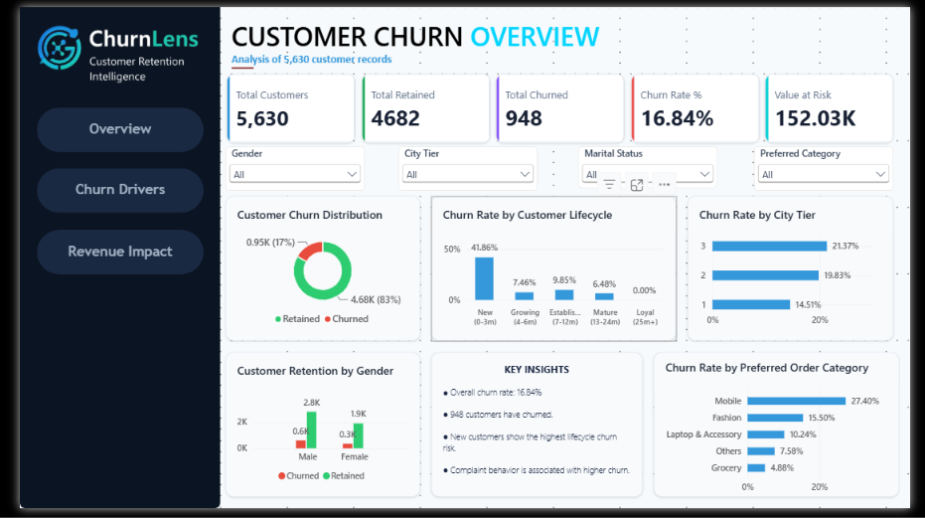
OVERALL CHURN LANDSCAPE
1 in 6 customers has churned — but the risk is not evenly distributed
CUSTOMERS
5,630
RETAINED
4,682
CHURNED
948
CHURN RATE
16.84%
Aggregate churn is meaningful — but alone it does not show where retention intervention should begin.
Source: Customer Churn & Retention Analytics | Python + MySQL + Power BI
CHURNLENS · 07

Slide 8
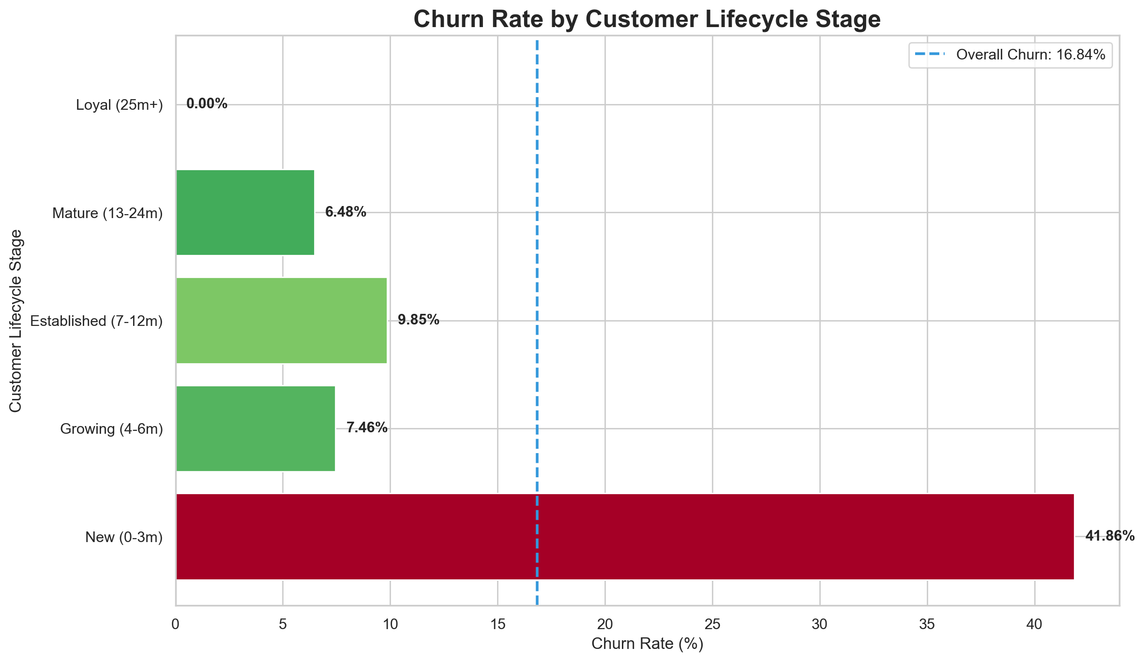
CHURN DRIVER · CUSTOMER LIFECYCLE
Early lifecycle is the strongest visible churn-risk point
NEW (0–3 MONTHS)
41.86%
653 of 948 churned customers
Later stages stay below 10%
Growing (4–6m)
7.46%
Established (7–12m)
9.85%
Mature (13–24m)
6.48%
Loyal (25m+)
0%
The first 3 months represent the highest observed churn-risk stage — onboarding is the priority retention window. Retention recovers to 92.54% at Growing and 100% at Loyal.
Source: Customer Churn & Retention Analytics | Python + MySQL + Power BI
CHURNLENS · 08

Slide 9
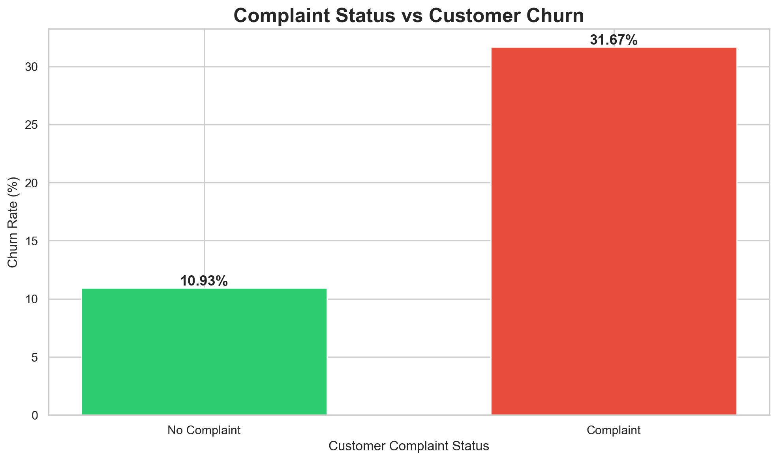
CHURN DRIVER · CUSTOMER EXPERIENCE
Complaint behavior is strongly associated with churn
COMPLAINT CHURN
31.67%
NO-COMPLAINT CHURN
10.93%
≈2.9× higher observed churn with complaints
COMPLAINT
SERVICE RECOVERY
FOLLOW-UP
RETENTION
Association, not causation.
Source: Customer Churn & Retention Analytics | Python + MySQL + Power BI
CHURNLENS · 09

Slide 10
OTHER CHURN SIGNALS
Churn risk varies across behavior and preference dimensions
Preferred payment mode — churn %
Preferred order category — churn %
Cash on Delivery
25%
Mobile
27.4%
E wallet
22.8%
Fashion
15.5%
CC
21.6%
Laptop & Accessory
10.2%
UPI
17.4%
Debit Card
15.3%
Others
7.6%
Credit Card
12.9%
Grocery
4.9%
Satisfaction score — churn % (non-monotonic)
Login device & demographics — churn %
Score 1
11.5%
Phone login
22.4%
Score 2
12.6%
Computer login
19.8%
Score 3
17.2%
Mobile Phone login
12.6%
Score 4
17.1%
Single (marital)
26.7%
Score 5
23.8%
City Tier 3
21.4%
Strongest numerical associations with churn: Tenure −0.34 · DaySinceLastOrder −0.16 · CashbackAmount −0.15
Source: Customer Churn & Retention Analytics | Python + MySQL + Power BI
CHURNLENS · 10

Slide 11
CUSTOMER VALUE & RISK SEGMENTATION
Customer value changes the priority of churn
Value quartiles (NTILE on value proxy) — churn %
RFM segments — churn % (notebook output)
Q1 · lowest
25.07%
Loyal Customers
15.49%
Q2
19.82%
Potential Loyalists
16.4%
Q3
11.51%
At Risk
17.66%
Q4 · highest
10.95%
Lost Customers
15.21%
Champions segment = 0 customers in this dataset.
HIGH VALUE + HIGH RISK
HIGH VALUE + LOW RISK
LOW VALUE + HIGH RISK
LOW VALUE + LOW RISK
PRIORITY RETENTION
LOYALTY / PROTECTION
AUTOMATED / LOW-COST RETENTION
STANDARD ENGAGEMENT
Proactive, human-led saves for exposed high-value customers
Milestone rewards to keep strong relationships strong
Trigger-based offers and digital nudges
Business-as-usual communication
Retention priority should consider both churn probability and customer value.
Source: Customer Churn & Retention Analytics | Python + MySQL + Power BI
CHURNLENS · 11

Slide 12
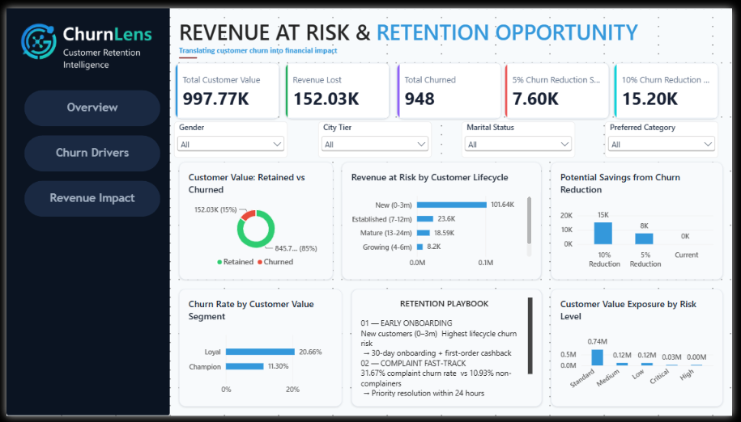
BUSINESS IMPACT · VALUE AT RISK
Churn converts into measurable customer-value exposure
TOTAL CUSTOMER-VALUE PROXY
₹997.77K
VALUE ASSOCIATED WITH CHURN
₹152.03K
15.24% of proxy
5% CHURN REDUCTION
10% CHURN REDUCTION
₹7.60K
₹15.20K
potential protected value
potential protected value
CUSTOMER CHURN
CHURNED CUSTOMER VALUE
VALUE AT RISK
RETENTION OPPORTUNITY
Value at risk by lifecycle: New ₹101.64K · Established ₹23.6K · Mature ₹18.59K · Growing ₹8.2K
Figures are CashbackAmount-derived customer-value proxy — not actual revenue.
Source: Customer Churn & Retention Analytics | Python + MySQL + Power BI
CHURNLENS · 12

Slide 13
PRIORITIZATION
Retention investment should start where risk and exposure overlap
P1
New customers · 0–3 months
EVIDENCE 41.86% churn · 653 of 948 churned · ₹101.64K value at risk
Highest lifecycle churn risk
P2
Customers with complaints
EVIDENCE 31.67% vs 10.93% churn (≈2.9×)
High observed churn association
P3
At-Risk / Lost value segments
EVIDENCE 17.66% / 15.21% RFM churn · critical-risk pool at 60.2%
Higher observed churn rates
P4
Growing / mid-tenure customers
EVIDENCE 7.46% today · retention dip −2.39pp at Established
Prevent migration into high-risk states
Priorities use observed associations from the analysis — no ROI claims are made.
Source: Customer Churn & Retention Analytics | Python + MySQL + Power BI
CHURNLENS · 13

Slide 14
RETENTION PLAYBOOK
Three targeted interventions address the strongest observed risk signals
01
EARLY ONBOARDING
02
COMPLAINT FAST-TRACK
03
LOYALTY / MILESTONE ENGAGEMENT
TARGET
TARGET
TARGET
New customers (0–3 months)
Customers who complain
Growing / mid-tenure customers
FINDING
FINDING
FINDING
Highest lifecycle churn risk (41.86%)
Complaint behavior strongly associated with churn (31.67% vs 10.93%)
Retention opportunity before customers enter higher-risk states
ACTION
ACTION
ACTION
30-day onboarding journey + first-order engagement / cashback intervention
Priority resolution + follow-up after resolution
6-month and 12-month milestone rewards / engagement
Interventions target observed risk signals; outcomes should be measured against pre-intervention churn.
Source: Customer Churn & Retention Analytics | Python + MySQL + Power BI
CHURNLENS · 14

Slide 15
MANAGEMENT ACTION PLAN
Turn the analysis into an operating retention program
0–30 DAYS
31–60 DAYS
61–90 DAYS
• Identify new-customer risk pool
• Launch onboarding intervention
• Evaluate retention outcomes
• Establish complaint fast-track
• Introduce service-recovery follow-up
• Compare churn before / after
• Create churn-risk monitoring view
• Monitor high-risk customer segments
• Refine customer segments
• Scale successful interventions
KPIs TO MONITOR
Churn Rate
Retention Rate
Complaint Churn Rate
New-Customer Churn
At-Risk Customer Count
Customer-Value Exposure
Review cadence: monthly retention review with Customer Success, CRM & Marketing.
Source: Customer Churn & Retention Analytics | Python + MySQL + Power BI
CHURNLENS · 15

Slide 16
EXECUTIVE CONCLUSION
Four takeaways for management
01
02
03
04
CHURN IS CONCENTRATED
CUSTOMER EXPERIENCE MATTERS
VALUE CHANGES PRIORITY
RETENTION HAS A MEASURABLE BUSINESS CASE
Early-lifecycle customers show disproportionately high churn (41.86% at 0–3m).
Complaint behavior is strongly associated with higher churn (31.67% vs 10.93%).
High-risk customer segments require value-aware retention decisions.
Reducing churn can protect part of the ₹152.03K customer-value exposure.
RECOMMENDED FOCUS
Prevent early churn → resolve complaints faster → protect high-risk customer value
Source: Customer Churn & Retention Analytics | Python + MySQL + Power BI
CHURNLENS · 16

Slide 17
TECHNICAL APPENDIX
Technical implementation
PYTHON
SQL · MySQL
BI · POWER BI
• Pandas · NumPy
• Aggregations & CASE WHEN
• Interactive dashboards
• Data cleaning & imputation
• CTEs & subqueries
• KPI reporting
• EDA & statistical exploration
• JOINs
• Segmentation views
• Feature transformation
• Window functions
• Business storytelling
• RFM & cohort analysis
• RANK · NTILE · LAG
3 pages: Overview · Drivers ·
Revenue Impact
df.isnull().sum()
df.duplicated().sum()
df['OrderCount'].fillna(median)
NTILE(4) OVER (
ORDER BY CashbackAmount)
RANK() OVER (ORDER BY
CashbackAmount DESC)
Analysis developed using Python, MySQL and Power BI
Source: Customer Churn & Retention Analytics | Python + MySQL + Power BI
CHURNLENS · 17

Slide 18
PROJECT ARCHITECTURE
End-to-end analytical ownership
RAW EXCEL
PYTHON DATA PREPARATION
CLEAN CSV
MYSQL ANALYTICAL DB
BUSINESS SQL LAYER
RISK / BUSINESS METRICS
POWER BI DASHBOARD
MANAGEMENT DECISION
Ingest & clean
Store & query
Visualize & decide
Python / Pandas
MySQL · CTEs · windows
Power BI · management review
One analyst-owned pipeline: raw records → decision-ready retention intelligence.
CHURNLENS · Customer Retention Intelligence · Thank you
Source: Customer Churn & Retention Analytics | Python + MySQL + Power BI
CHURNLENS · 18

